Slide 1

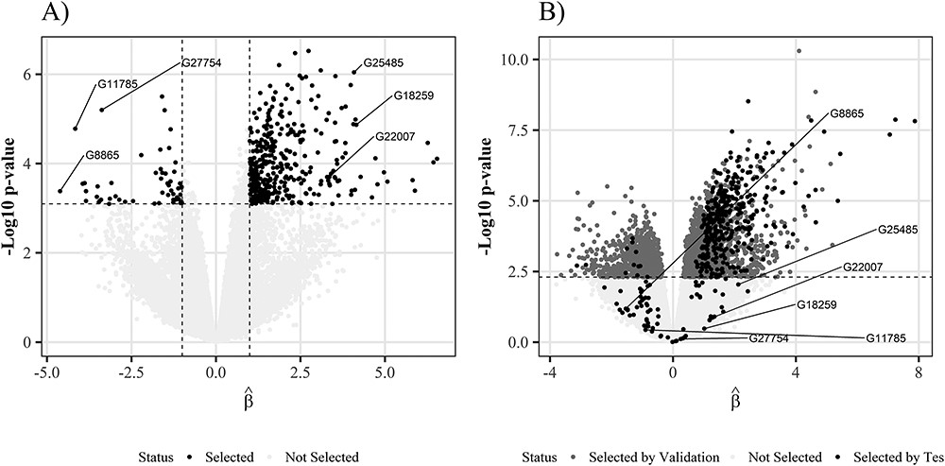
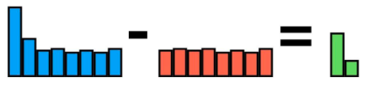
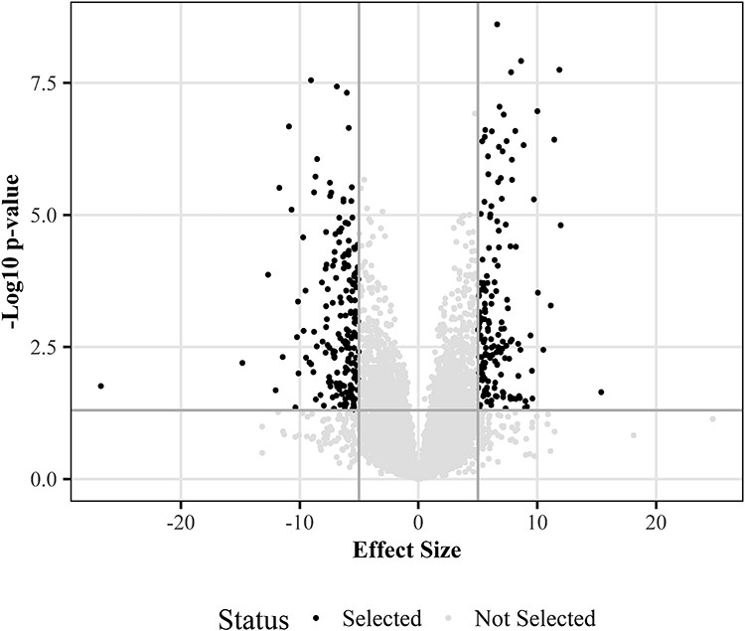

FALSE DISCOVERY RATE CONTROL IN VOLCANO PLOT FOR OMICS DATA
Célia Vidal & Vivien Dupont Data Science in Health & Biostatistics, 3rd year, Ensai
Introduction
Objectives
Results
False discovery rate
By construction of hypothesis testing there is always a chance to wrongly reject the null hypothesis. For a single test, this is known as the type I error. When working with Omics data, the datasets are usually huge. That means as many chances to be wrong when hypothesis testing. That why we introduce the False Discovery Rate (FDR) as the expectation of the proportion of false positives hypothesis :
$$FDR= 𝔼\left( \frac{\# false positives}{\# Hypothesis} \right)$$
Benjamini-Hochberg method
The Benjamini-Hochberg procedure for controlling the FDR is one of the most widely used procedures for p-value adjustment. It controls the proportion of false positives at an alpha level (usually 0.05). It reads as follow :
Sort p-values : $p_{(1)}≤…≤p_{\left(m\right)}$
Define $\hat{I}=max⁡\{k|p_{\left(k\right)}≤α\frac{k}{m}\}$
Reject all $i$ such that $p_{i}≤p_{\hat{I}}$
Volcano plots
When to many discoveries remain after application of the Benjamini-Hochberg procedure, the double filtering procedure can be applied, which keeps only the p-values that have a large effect size. This double filtering procedure is represented by a Volcano plot.
The procedure of Benjamini-Hochberg does not guarantee error control on the subsets and therefore it can inflated the False Discovery Rate. To maintain control of the FDR, the FDP and total number of positives must be reduced at the same time, which is not necessarily the case with the Benjamini-Hochberg method.
Two approaches are proposed to overcome this weakness, the Focused Benjamini-Hochberg and the Closed testing.
In the real case study, the database contains 49 individuals and 58037 genes. Authors use a resampling method with 6 individuals for the test sample and 37 individuals for the validation sample. If among the 37 individuals there are significant genes for BH (adjusted P-value for BH <0.05) then they are considered differentially expressed.
If differentially expressed gene in the validation sample and test → true positive (TP);
If gene differentially expressed in the validation sample and not differentially expressed in the test sample (or vice versa) → false positive (FP);
If gene not differentially expressed in validation sample and test → true negative (TN).
17% of the genes selected by the volcano plot in the test sample were not significant in the validation. Filtering the results may lead to FDP inflation and that a large effect size does not necessarily imply that the result is a true positive.
◀
FIGURE 2 : Volcano plot of the real case study
Methods
Focused Benjamini-Hochberg:
Closed testing:
◀
FIGURE 1: Volcano plot
Conclusion
FDR inflation occurs when FDR control procedures such as BH are combined with the Volcano Plots double filter procedure. FDR control on a set of discoveries does not imply FDR control on subsets of these discoveries. FDR inflation is high when the variance of differentially expressed genes is lower than the variance of non-differentially expressed genes. FDR inflation is less important when there are high correlations or a low proportion of null genes. Closed testing and focused Benjamini-Hochberg are two alternatives to the Benjamini-Hochberg procedure that allow double screening while controlling the FDR.
The Volcano plot is a scatter plot of -log10 of p-values among significant p-values after Benjamini-Hochberg correction (y-axis) versus effect size (x-axis). The most significant variables are on the right and left corners.
Bibliography
Ebrahimpoor (2021) Inflated false discovery rate due to volcano plots: problem and solutions

